Slide 1
Queuing Theory
Dr. Sk. Md. Masudul Ahsan
Associate Professor, Dept. of CSE, KUET

Slide 2
Queuing System (elements)
Waiting for service is part of our daily life. We queue up for
Bus, check out counter etc.
Not only for human, jobs wait to be processed on a machine
Study of queue quantifies the phenomenon of waiting lines using
Average queue length, average waiting time, average facility utilization
Thereby reduce the adverse impact of waiting to tolerable levels

Slide 3
Queuing System
A queuing system is a facility consisting of one or several servers designed to perform certain tasks or process certain jobs and a queue of jobs waiting to be processed.
Examples of queuing systems are:
a shared computer executing tasks sent by its users;
an internet service provider whose customers connect to the internet, browse, and disconnect;
a printer processing jobs sent to it from different computers;
a medical office serving patients; and so on.

Slide 4
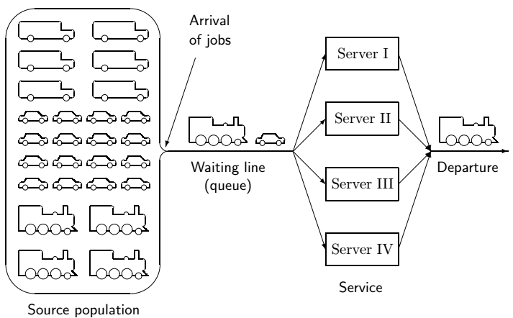
Queuing System
Main components

Slide 5
Queuing System - Input process
Usually called the arrival process.
Arrivals are called customers.
We assume that no more than one arrival can occur at a given instant.
If more than one arrival can occur at a given instant, we say that bulk arrivals are allowed.
Models in which arrivals are drawn from a small population are called finite source models.
If a customer arrives but fails to enter the system, we say that the customer has balked.

Slide 6
Queuing System - Output process
To describe the output process of a queuing system, we usually specify a probability distribution – the service time distribution – which governs a customer’s service time.
Two arrangements of servers:
Servers are in parallel if all server provide the same type of service and a customer need only pass through one server to complete service.
Servers are in series if a customer must pass through several servers before completing service.

Slide 7
Queuing System - Queue discipline
Describes the method used to determine the order in which customers are served.
The most common - FCFS discipline (first come, first served), served in order of their arrival.
LCFS discipline (last come, first served), the most recent arrivals are the first to enter service.
Customer is randomly chosen from waiting line - SIRO discipline (service in random order).
Priority queuing disciplines - classifies each arrival into one of several categories.
Each category is then given a priority level, and within each priority level served on an FCFS basis.

Slide 8

Modeling Arrival and Service Processes
We define t_{i} to be the time at which the ith customer arrives.
we define T_{i} = t_{i+1} - t_{i} to be the ith interarrival time.
In modeling the arrival process we assume that the T_{i}’s are independent, continuous random variables described by A having a density function a(t).
The assumption that each interarrival time is governed by the same random variable implies that the distribution of arrivals is independent of the time of day or the day of the week.
This is the assumption of stationary interarrival times.
Stationary-(whose distribution characteristics do not change over time)

Slide 9
Modeling Arrival and Service Processes
The independence assumption means, for example, that the value of T₂ has no effect on the value of T₃, T₄, or any later T_{i}
Stationary interarrival ties is often unrealistic, but we may often approximate reality by breaking the time of day into segments.
A negative interarrival time is impossible. This allows us to write
We define λ to be the arrival rate or units of arrivals per hour
So, 1/λ to be the mean or average interarrival time or units of hours per arrival.

Slide 10
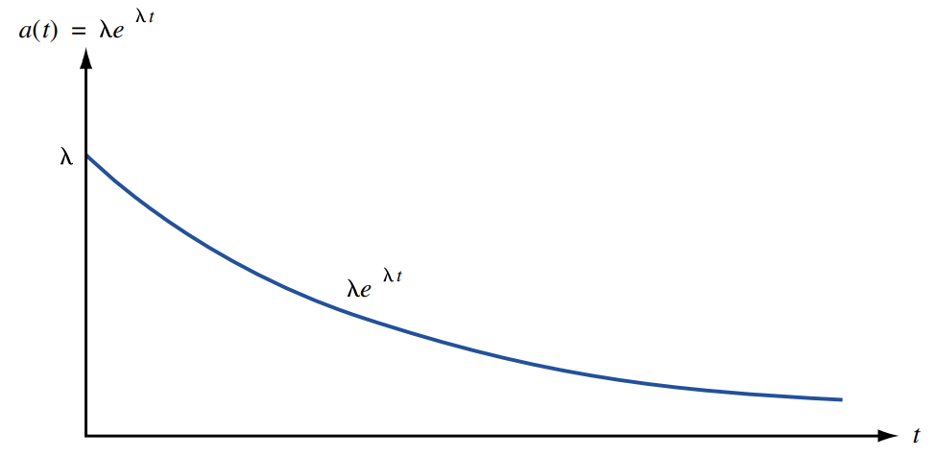
Modeling Arrival and Service Processes
How to choose A - to reflect reality and still be computationally tractable.
The most common choice for A is the exponential distribution.
An exponential distribution with parameter λ has a density
a(t) = λe^{-λt.}
We can show that the average or mean by
And Variance by

Slide 11
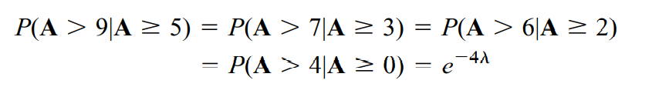
Modeling Arrival and Service Processes
Lemma 1: If A has an exponential distribution, then for all nonnegative values of t and h,
For example, if h=4, then (5) yields, for t=5, t=3, t=2, and t=0
For reasons that become apparent, a density that satisfies the equation is said to have the no-memory property.
The no-memory property of the exponential distribution is important because it implies that if we want to know the probability distribution of the time until the next arrival, then it does not matter how long it has been since the last arrival.
(5)

Slide 12

Modeling the Service Process
We assume that the service times of different customers are independent random variables and that each customer’s service time is governed by a random variable S having a density function s(t).
We let 1/µ be then mean service time for a customer.
so µ is service rate or µ has units of customers per hour.
For example, µ=5 means that if customers were always present, the server could serve an average of 5 customers per hour, and the average service time of each customer would be 1/5 hour.
As with interarrival times, we hope that service times can be accurately modeled as exponential random variables
Unfortunately, actual service times may not be consistent with the no-memory property.

Slide 13
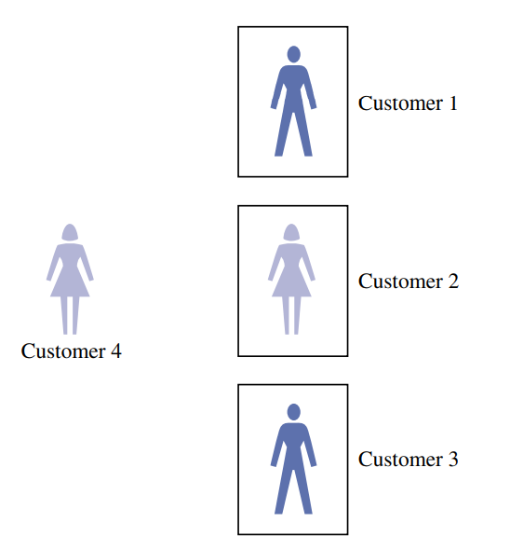
Suppose all three servers are busy, and a customer is waiting
What is the probability that the customer who is waiting will be the last of the four customers to complete service?
One of customers 1–3 (say, customer 3) will be the first to complete service.
Then customer 4 will enter service.
By the no-memory property, customer 4’s service time has the same distribution as the remaining service times of customers 1 and 2.
Thus, by symmetry, customers 4, 1, and 2 will have the same chance of being the last customer to complete service.
This implies that customer 4 has a 1/3 chance of being the last customer to complete service.
Without the no-memory property, this problem would be hard to solve

Slide 14
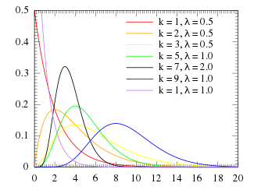
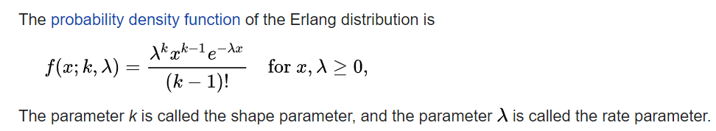
Modeling the Service Process
Actual service times may not be consistent with the no-memory property.
For this reason, we often assume that s(t) is an Erlang distribution with shape parameters k and rate parameter kµ.
In certain situations, interarrival or service times may be modeled as having zero variance; in this case, interarrival or service times are considered to be deterministic.
For example, is interarrival times are deterministic, then each interarrival time will be exactly 1/λ, and is service times are deterministic, each customer’s service time is exactly 1/µ.
The Erlang distribution was developed by A. K. Erlang to examine the number of telephone calls which might be made at the same time to the operators of the switching stations.

Slide 15
The Kendall-Lee Notation for Queuing Systems
Standard notation used to describe many queuing systems.
The notation is used to describe a queuing system in which all arrivals wait in a single line until one of s identical parallel servers id free. Then the first customer in line enters service, and so on.
To describe such a queuing system, Kendall devised the following notation.
Each queuing system is described by six characters: 1/2/3/4/5/6

Slide 16
The Kendall-Lee Notation for Queuing Systems
The first characteristic specifies the nature of the arrival process. The following standard abbreviations are used:
M = Interarrival times are independent, identically distributed (iid) having an exponential distribution.
D = Interarrival times are iid and deterministic
E_{k} = Interarrival times are iid Erlangs with shape parameter k.
GI = Interarrival times are iid and governed by some general distribution

Slide 17
The Kendall-Lee Notation for Queuing Systems
The second characteristic specifies the nature of the service times:
M = Service times are iid and exponentially distributed
D = Service times are iid and deterministic
E_{k} = Service times are iid Erlangs with shape parameter k.
G = Service times are iid and governed by some general distribution

Slide 18
The Kendall-Lee Notation for Queuing Systems
The third characteristic is the number of parallel servers.
The fourth characteristic describes the queue discipline:
FCFS = First come, first served
LCFS = Last come, first served
SIRO = Service in random order
The fifth characteristic specifies the maximum allowable number of customers in the system.
The sixth characteristic gives the size of the population from which customers are drawn.

Slide 19
The Kendall-Lee Notation for Queuing Systems
In many important models 4/5/6 is GD/∞/∞. If this is the case, then 4/5/6 is often omitted.
M/E₂/8/FCFS/10/∞ might represent a health clinic with 8 doctors, exponential interarrival times, two-phase Erlang service times, an FCFS queue discipline, and a total capacity of 10 patients.

Slide 20
Birth-Death Processes
We will use it to answer questions about several different types of queuing systems.
Number of people present in any queuing system at time t to be the state of the queuing systems at time t.
P_{ij}(t) which is defined as the probability that j people will be present in the queuing system at time t, given that at time 0, i people are present.
We call π_{j} the steady state, or equilibrium probability, of state j.
The behavior of P_{ij}(t) before the steady state is reached is called the transient behavior of the queuing system.
A birth-death process is a continuous-time stochastic process for which the system’s state at any time is a nonnegative integer.

Slide 21
Laws of Motion for Birth-Death
Law 1
With probability λ_{j}Δt+o(Δt), a birth occurs between time t and time t+Δt.
A birth increases the system state by 1, to j+1.
The variable λ_{j} is called the birth rate in state j.
In most queuing systems, a birth is simply an arrival.
Law 2
With probability µ_{j}Δt+o(Δt), a death occurs between time t and time t + Δt. A death decreases the system state by 1, to j-1. The variable µ_{j} is the death rate in state j. In most queuing systems, a death is a service completion.
Note that µ₀ = 0 must hold, or a negative state could occur.
Law 3
Births and deaths are independent of each other.

Slide 22
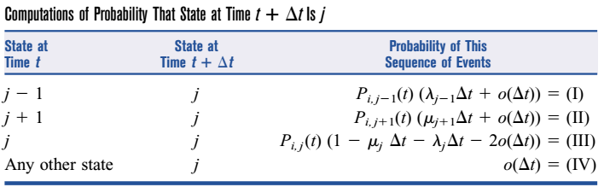
Birth-Death Processes
λ₀
λ₁
λ₂
λ_{j-2}
λ_{j-1}
λ_{j}
λ_{j+1}
0
1
2
….
j-1
0
j
j+1
….
μ₁
μ₂
μ₃
μ_{j-1}
μ_{j}
μ_{j+1}

Slide 23
Relation of Exponential Distribution to Birth-Death Processes
Most queuing systems with exponential interarrival times and exponential service times may be modeled as birth-death processes.
More complicated queuing systems with exponential interarrival times and exponential service times may often be modeled as birth-death processes by adding the service rates for occupied servers and adding the arrival rates for different arrival streams.

Slide 24
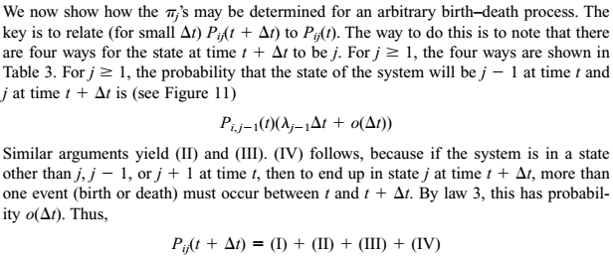
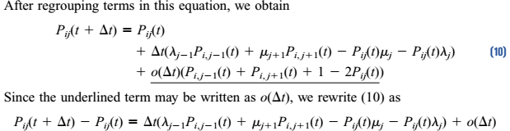

Slide 25
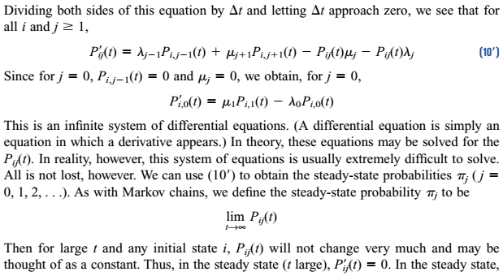

Slide 26
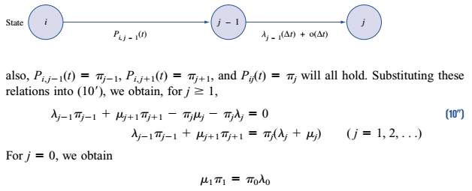

Slide 27
Steady-State Probabilities for Birth-Death Processes
We now show how the π_{j}’s may be determined for an arbitrary birth-death process.
The key role is to relate (for small Δt) P_{ij}(t+Δt) to P_{ij}(t).
The above equations are often called the flow balance equations, or conservation of flow equations, for a birth-death process.
= Expected no. of entrances into state j
= Expected no. of departures from state j

Slide 28
Solution of Balance Eq.
We obtain the flow balance equations for a birth-death process:
λ₀
λ₁
λ₂
λ_{j-2}
λ_{j-1}
λ_{j}
λ_{j+1}
0
1
2
….
j-1
0
j
j+1
….
μ₁
μ₂
μ₃
μ_{j-1}
μ_{j}
μ_{j+1}

Slide 29
Solution of Balance Eq.
The requirement is that

Slide 30
Solution of Balance Eq.
If is finite, we can solve for π₀:
It can be shown that if is infinite, then no steady-state distribution exists.
The most common reason for a steady-state failing to exist is that the arrival rate is at least as large as the maximum rate at which customers can be served.

Slide 31
Birth Death Process
λ₀
λ₁
λ₂
λ_{j-2}
λ_{j-1}
λ_{j}
λ_{j+1}
0
1
2
….
j-1
0
j
j+1
….
μ₁
μ₂
μ₃
μ_{j-1}
μ_{j}
μ_{j+1}

Slide 32
M/M/1/GD/∞/∞ Queuing System
λ
λ
λ
λ
λ
λ
λ
0
1
2
….
j-1
0
j
j+1
….
μ
μ
μ
μ
μ
μ
Here, λ_{j} = λ j= 0, 1, 2, …
μ₀ = 0
μ_{j} = μ j= 1, 2, …
Let, the traffic intensity be ρ = λ /μ and 0 ≤ ρ < 1

Slide 33
M/M/1/GD/∞/∞ Queuing System
λ
λ
λ
λ
λ
λ
λ
0
1
2
….
j-1
0
j
j+1
….
μ
μ
μ
μ
μ
μ
If ρ ≥ 1, the infinite sum “blows up”, thus, no steady-state distribution exists.
So, rest of this section, we assume ρ < 1,

Slide 34
M/M/1/GD/∞/∞ Queuing System
The steady state parameters we are interested in
L = average number of customers in the queuing system
L_{q} = expected no. of customers waiting in the queue
L_{S} = expected no. of customers in service
= average number of busy server = C ′
L = L_{q} + L_{S}

Slide 35
M/M/1/GD/∞/∞ Queuing System
The steady state parameters we are interested in
W = average time a customer spends in the system
= average response time
W_{q} = average time a customer spends in line
W_{s} = average time a customer spends in service
For any queuing system in which a steady-state distribution exists, the following relations hold: L = λW L_{q} = λW_{q} L_{s} = λW_{s}
Utilization = C′/C
Little’s Queuing Formula L = λ_{eff} W

Slide 36
M/M/1/GD/∞/∞ Queuing System
Derivation of L
We know that, E(X) = ∑[x f(x)] and P(X=x) =f(x)
X = no. of customer in the system during steady state
X can have values j = 0, 1, 2, … with probability π_{j}

Slide 37




M/M/1/GD/∞/∞ Queuing System
Derivation of L
Another way

Slide 38
M/M/1/GD/∞/∞ Queuing System
Derivation of L_{q}
Let, the system in state j=0,1,2,… with probability π_{j}
i.e. there are j customer in the system now
Since only 1 server, there are j-1 customer is waiting in queue

Slide 39
M/M/1/GD/∞/∞ Queuing System
Derivation of L_{S}
If we already know L and L_{q}
If we already know L and L_{S}

Slide 40
M/M/1/GD/∞/∞ Queuing System
Example 4 (Winston)
Suppose that all car owners fill up when their tanks are exactly half full.
At the present time, an average of 7.5 customers per hour arrive at a single-pump gas station.
It takes an average of 4 minutes to service a car.
Assume that interarrival and service times are both exponential.
What is the probability that the teller is idle?
For the present situation, compute L , Lq and W, Wq.

Slide 41
M/M/1/GD/∞/∞ Queuing System
Suppose that a gas shortage occurs and panic buying takes place.
To model the phenomenon, suppose that all car owners now purchase gas when their tank are exactly three quarters full.
Since each car owner is now putting less gas into the tank during each visit to the station, we assume that the average service time has been reduced to 3 1/3 =(10/3)minutes.
How has panic buying affected L and W?

Slide 42
Solutions
We have an M/M/1/GD/∞/∞ system with
λ = 7.5 cars per hour µ = 60/4=15 cars per hour.
ρ = 7.5/15 = 0.5
Idle probability π₀ = 1 − ρ = 0.5
L = ρ/(1 − ρ)= .50/(1 − 0.5) = 1,
W = L/λ = 1/7.5 = 0.13 hour = 8 mins.
L_{q} = ρ²/(1- ρ)= 0.25/(1 − 0.5) = 0.5
W_{q} = L_{q}/λ = 0.5/7.5 =1/15 hr = 4 mins.
Hence, in this situation, everything is under control, and long lines appear to be unlikely.

Slide 43
Solutions
We now have an M/M/1/GD/∞/∞ system with
λ = 2*7.5 =15 cars per hour
µ = 60*3/10=18 cars per hour.
ρ = 15/18 =5/6
Thus, panic buying has cause long lines.

Slide 44
M/M/s/GD/ ∞ /∞ Queuing System
λ
λ
λ
λ
λ
λ
λ
0
1
2
….
s-1
0
s
s+1
….
μ
2μ
3μ
(s-1)μ
sμ
sμ
Here, λ_{j} = λ j= 0, 1, 2, …
μ_{j} = jμ j= 0, 1, 2, …,s
μ_{j} = sμ j= s+1, s+2, …
Let, the traffic intensity be ρ = λ /(sμ) and 0 ≤ ρ < 1

Slide 45
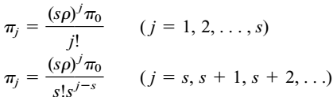
M/M/s/GD/∞/∞ Queuing System
If ρ ≥ 1, the infinite sum “blows up”, thus, no steady-state exists.

Slide 46



M/M/s/GD/∞/∞ Queuing System
steady-state probability that all servers are busy

Slide 47
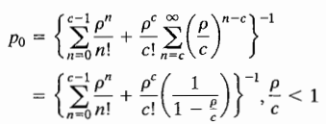

M/M/s/GD/∞/∞ Queuing System
Taha version
ρ = λ /μ, c = s, π₀ = p₀
These are actually same as the previous ones

Slide 48


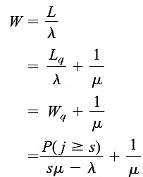

M/M/s/GD/∞/∞ Queuing System

Slide 49
M/M/s/GD/∞/∞ Queuing System
As M/M/2 system
λ = 8 μ = 60/12 = 5 s = 2 ρ = λ/sμ= 0.8

Slide 50
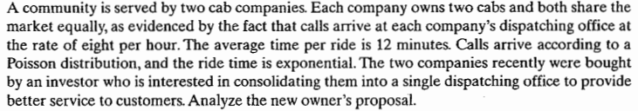
M/M/s/GD/∞/∞ Queuing System
As M/M/2 system
λ = 8 μ = 60/12 = 5 s = 2 ρ = λ/sμ= 0.8

Slide 51
M/M/s/GD/∞/∞ Queuing System
As M/M/2 system
λ = 8 μ = 60/12 = 5 s = 2 ρ = λ/sμ= 0.8

Slide 52
M/M/s/GD/∞/∞ Queuing System
As M/M/4 system
λ = 2*8=16 μ = 60/12 = 5 s = 2*2 ρ = λ/sμ= 0.8

Slide 53
M/M/s/GD/∞/∞ Queuing System
As M/M/4 system
λ = 2*8=16 μ = 60/12 = 5 s = 2*2 ρ = λ/sμ= 0.8

Slide 54
Waiting Time Distribution of M/M/s/FCFS/∞/ ∞
Average waiting time Wq is independent of queue discipline
But is probability distribution is not
For FCFS queue with s=1
System waiting time distribution : exponential with parameter μ - λ
Queue waiting time distribution

Slide 55
Waiting Time Distribution of M/M/s/FCFS/∞/ ∞
Average waiting time Wq is independent of queue discipline
But is probability distribution is not
For FCFS queue with s=1
For M/M/1
About 37% customer wait longer
than average waiting time

Slide 56
Waiting Time Distribution of M/M/s/FCFS/∞/ ∞
Average waiting time Wq is independent of queue discipline
But is probability distribution is not
For FCFS queue with s=1
Gas buying : probability of waiting more than 4 min in queue, where λ = 7.5 cars per hour µ = 60/4=15

Slide 57
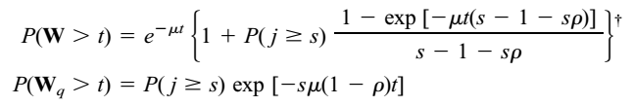
Waiting Time Distribution of M/M/s/FCFS/∞/ ∞
Average waiting time Wq is independent of queue discipline
But is probability distribution is not
For FCFS queue with s

Slide 58
M/M/1/GD/ n /∞ Queuing System (means(16.4a)) (14.8a)
λ
λ
λ
λ
λ
0
1
2
….
n-1
0
n
μ
μ
μ
μ
μ
Here, λ_{j} = λ j= 0, 1, 2, …n-1
λ_{j} = 0
μ₀ = 0
μ_{j} = μ j= 1, 2, …,n
Let, the traffic intensity be ρ = λ /μ and ρ ≥ 0

Slide 59
M/M/1/GD/n/∞ Queuing System (16.4a) (14.8a)

Slide 60
M/M/1/GD/n/∞ Queuing System (16.4a) (14.8a)

Slide 61
M/M/1/GD/n/∞ Queuing System (16.4a) (14.8a)
Derivation of L_{S}

Slide 62

M/M/1/GD/n/∞ Queuing System – Example (16.4b) (14.8b)
A car wash facility with single bay for wash and 4 parking space, arrival rate = 4 / hr, service time = 10 min / car, all are exponential [Taha Problem 15.6D]
Determine the following
Here
(a)

Slide 63
M/M/1/GD/n/∞ Queuing System - Example
(b)
(d)
(c)
Expected empty parking spaces = 4 − Lq = 3.212

Slide 64
M/G/1/GD/∞/ ∞
interarrival times are exponential, let λ be the arrival rate
but the service time distribution (S) is not
Let, 1/μ = E(S) and σ² = var S
It is not a birth–death process
because the probability that a service completion occurs between t and t+Δt when the state of the system at time t is j depends on the length of time since the last service completion.
Determination of the steady-state probabilities for M/G/1/GD/∞/∞ queuing system is a difficult matter.
Fortunately, however, utilizing the results of Pollaczek and Khinchin, we may determine L_{q}, L, L_{s}, W_{q}, W, W_{s}.
Notes:
In Kendall’s notation, such a queuing system is described as an M/G/1/GD/∞/∞ queuing system. An M/G/1/GD/∞/∞ system is not a birth–death process, because the probability that a service completion occurs between t and t + Δt when the state of the system at time t is j depends on the length of time since the last service completion (because service times no longer have the no-memory property). Thus, we cannot write the probability of a service completion between t and t + Δt in the form μΔt, and a birth–death model is not appropriate

Slide 65
M/G/1/GD/∞/ ∞
Pollaczek and Khinchin showed that for the M/G/1/GD/∞/∞ queuing system,
It can also be shown that π₀ = 1 − ρ.
The result is similar to the one for the M/M/1/GD/∞/∞ system.

Slide 66
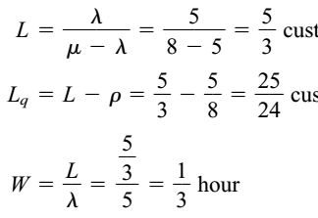
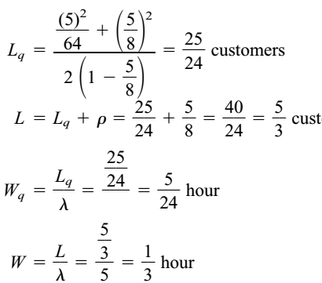

M/G/1/GD/∞/ ∞
consider an M/M/1/GD/∞/∞ system with λ=5 customers per hour and μ = 8 customers per hour
Considering it as a M/G/1 system
E(S) =1/μ = 1/8
σ² = 1/μ² =1/64 [since S is exponential]

Slide 67
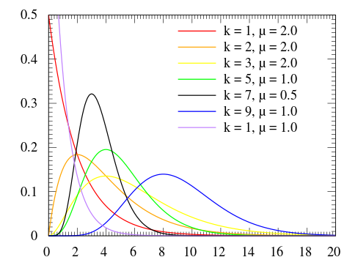


M/G/1/GD/∞/ ∞
Erlang Distribution is a two parameter family of continuous probability distributions with support x ∈ [ 0 , ∞ )
The two parameters are:
a positive integer k the "shape", and
a positive real number λ , the "rate". The "scale", μ , the reciprocal of the rate, is sometimes used instead.
It is a special case of the Gamma distribution.
The probability density function is
Or

Slide 68
M/G/1/GD/∞/ ∞
Erlang Distribution
Mean: k / λ.
Variance: k / λ².
Erlang distribution with k = 1 simplifies to exponential distribution.
Consider an M/G/1/GD/∞/∞ queuing system in which an average of 10 arrivals occur each hour. Suppose that each customer’s service time follows an Erlang distribution, with rate parameter 1 customer per minute and shape parameter 4. [ Winston page 1098]
Find the expected number of customers waiting in line.
Find the expected time that a customer will spend in the system.
What fraction of the time will the server be idle?

Slide 69
M/G/1/GD/∞/ ∞
Since, Erlang Distribution

Slide 70
M/G/1/GD/∞/ ∞
Find the expected number of customers waiting in line.
Find the expected time that a customer will spend in the system.
What fraction of the time will the server be idle?

Slide 71
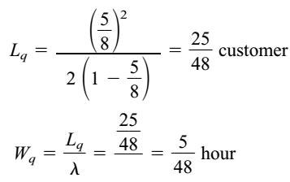
M/D/1/GD/∞/ ∞
consider an M/D/1/GD/∞/∞ system with λ=5 customers per hour and μ = 8 customers per hour
E(S) =1/μ = 1/8
σ² = 0
a typical customer will spend only half as much time in line as in an M/M/1/GD/∞/∞ queuing system with identical arrival and service rates.
even if mean service times are not decreased, a decrease in the variability of service times can substantially reduce queue size and customer waiting time

Slide 72
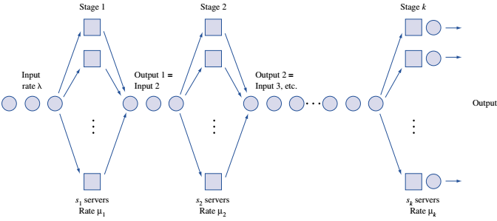
Exponential Queues in Series Networks
In the queuing models that we have studied so far, a customer’s entire service time is spent with a single server.
In many situations the customer’s service is not complete until the customer has been served by more than one server.
k-stage series queuing system

Slide 73
Exponential Queues in Series Networks
Theorem
If
interarrival times for a series queuing system are exponential with rate λ,
service times for each stage i server are exponential, and
each stage has an infinite-capacity waiting room,
then interarrival times for arrivals to each stage of the queuing system are exponential with rate λ.

Slide 74
Exponential Queues in Series Networks
The last two works in a car manufacturing process are installing the engine and putting on the tires. An average of 54 cars per hour arrive requiring these two tasks.
One worker is available to install the engine and can service an average of 60 cars per hour.
After the engine is installed, the car goes to the tire station and waits for its tires to be attached. Three workers serve at the tire station. Each works on one car at a time and can put tires on a car in an average of 3 minutes.
Both interarrival times and service times are exponential.
Determine the mean queue length at each work station.
Determine the total expected time that a car spends waiting for service

Slide 75


Exponential Queues in Series Networks
This is a series queuing system with
λ=54 cars per hour, s₁ = 1, μ₁ = 60 cars per hour,
s₂ = 3, and μ₂ = 20 cars per hour
Since λ < μ₁ and λ <3μ₂ , neither queue will “blow up,”
For stage 1 (engine), ρ = 54/60 = 0.9

Slide 76
Exponential Queues in Series Networks
For stage 2 (Tires), ρ = 54/(3*20) = 0.9
total expected waiting time is
0.15 +0.137 = 0.287 hour

